Slide 1


Data Analysis
Sellers’ Performance
Andre Kim Scarton

Slide 2


Personal Presentation
Name: Andre Kim Scarton
Age: 26

Slide 3

Topics
Problem
Target
Process Flow
3
Data Processing
Exploratory Analysis
Algorithm
6
Dashboard

Slide 4




Problem
See how sellers are performing
Metrics
Number of products sold
Total amount sold
History of products sold
History of the total amount sold
Goal
Product distribution
Sales distribution by customer

Slide 5


Target
Create a dashboard Where managers can see key matrics for performance analysis

Slide 6







Process Flow
Data processing
Data Analysis
Final Table

Slide 7


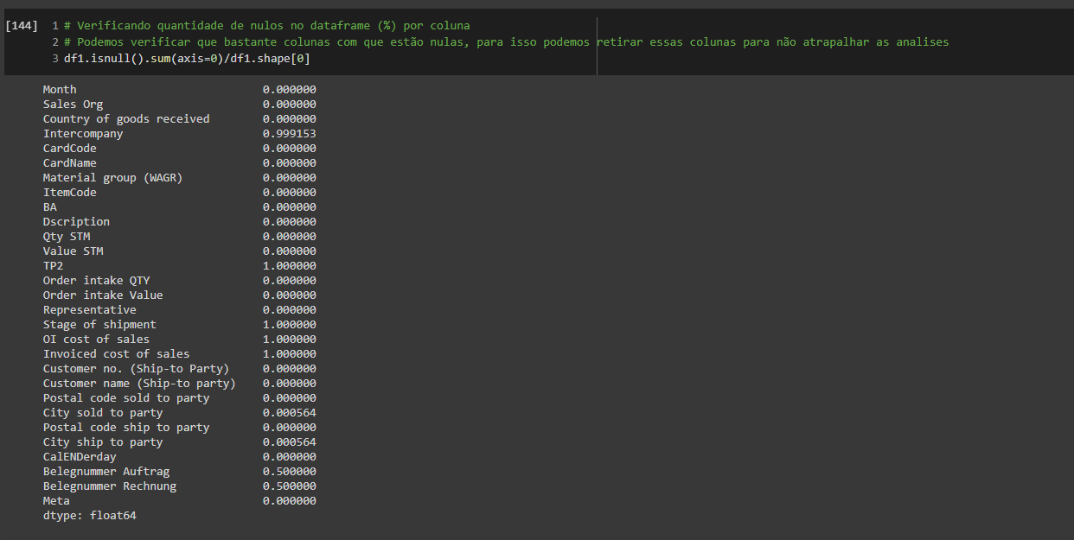
Data Processing
Checking for missing in the Total_registros base
7columns were practically out of records so these columns were dropped
Total_registros
29 columns
3543 record
Nomes Representante
2 columns
25 record

Slide 8
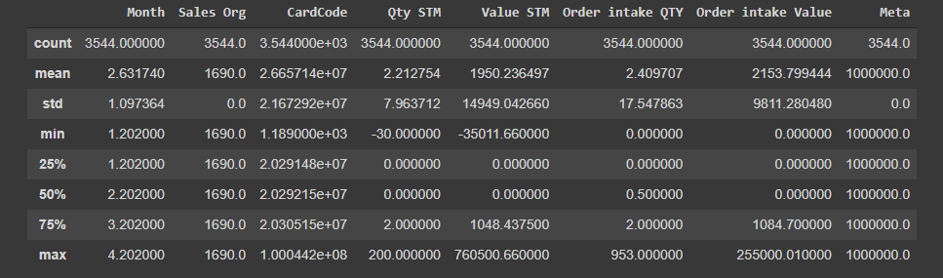
Data Processing
Basic statistical detail

Slide 9
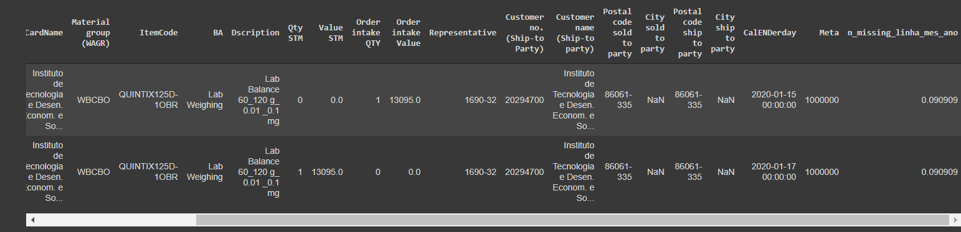
Data Processing
Only two records have any empty cells

Slide 10
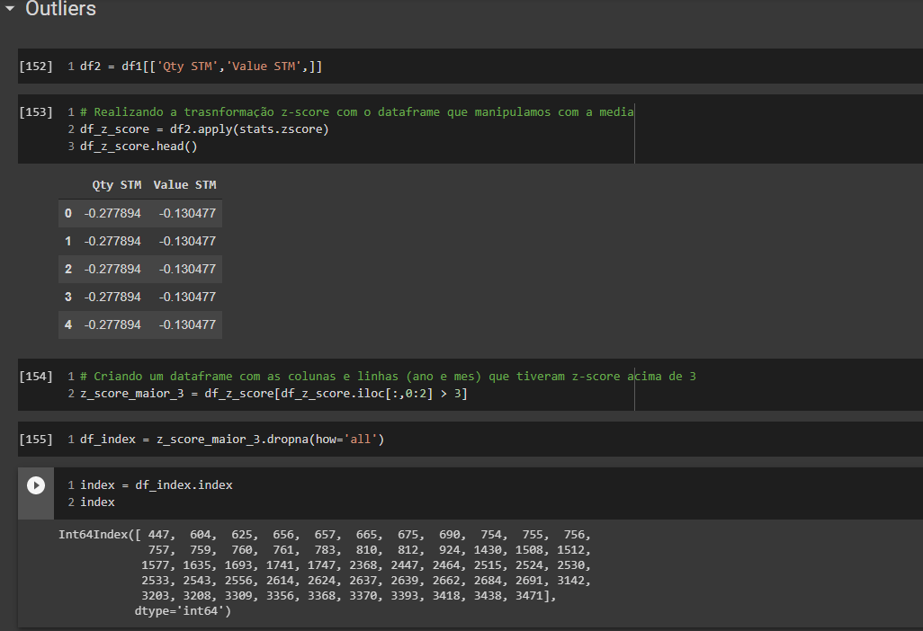
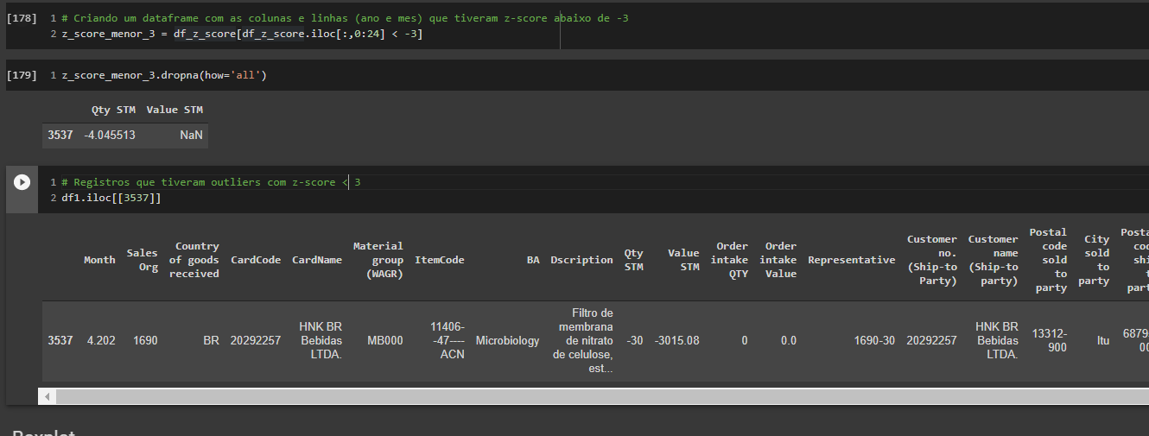
Data Processing
Outliers
The z-score method was used to analyze outliers
Where 55 outlier records were found with the z-socre method

Slide 11
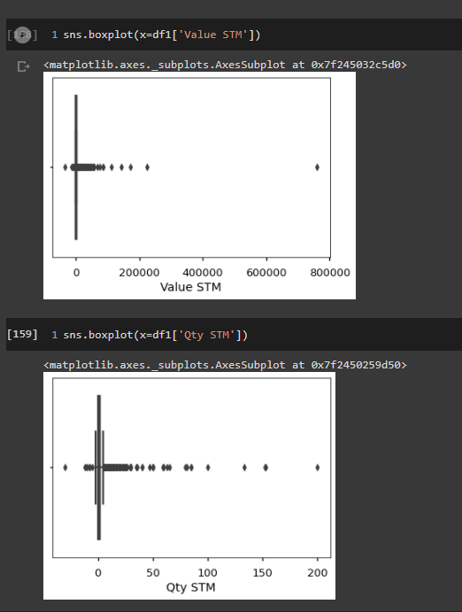
Data Processing
Boxplot
Checking outliers with Boxplot

Slide 12

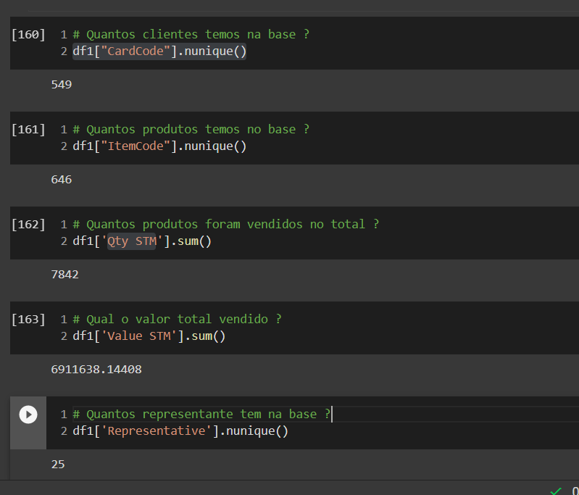
Exploratory Analysis

Slide 13
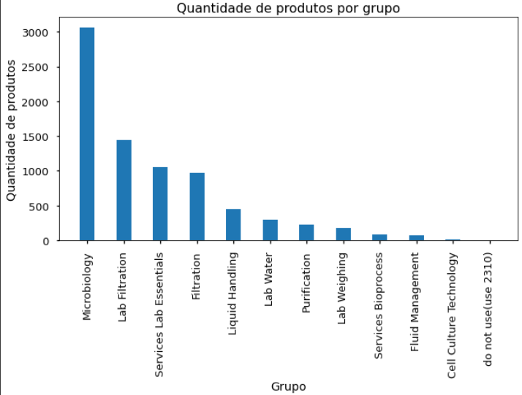
Exploratory Analysis
Number of products sold by group

Slide 14
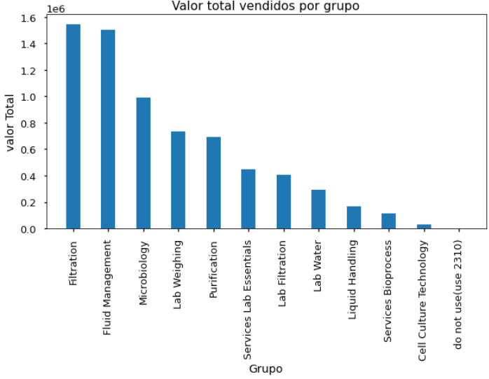
Exploratory Analysis
Total amount sold per group

Slide 15
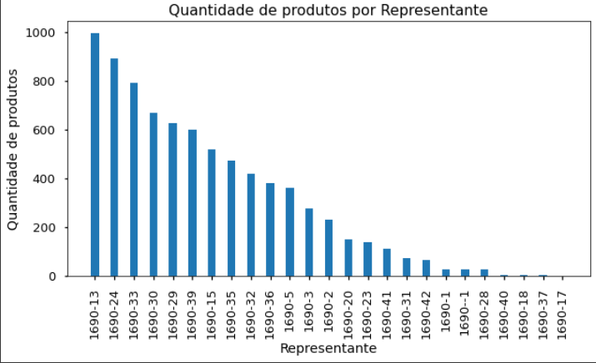
Exploratory Analysis
Number of products sold per representative

Slide 16
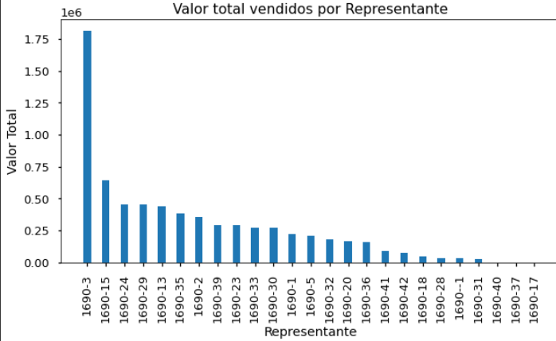
Exploratory Analysis
Total amount sold per representative

Slide 17
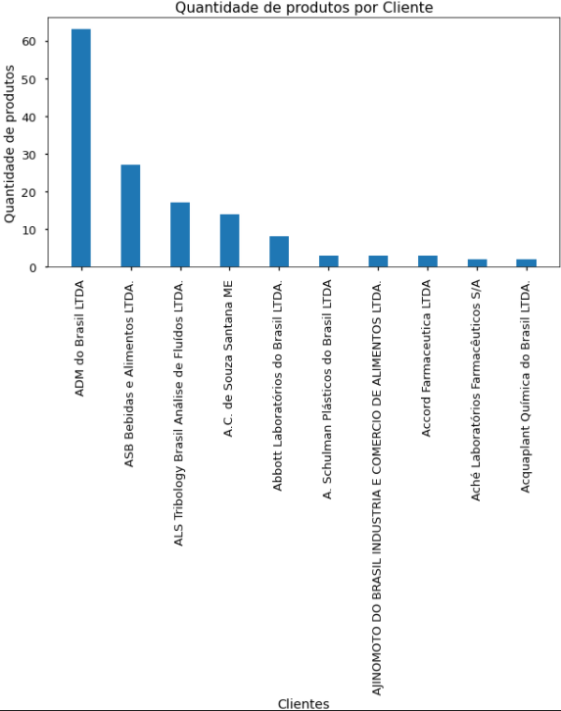
Exploratory Analysis
Number of products sold per customer

Slide 18
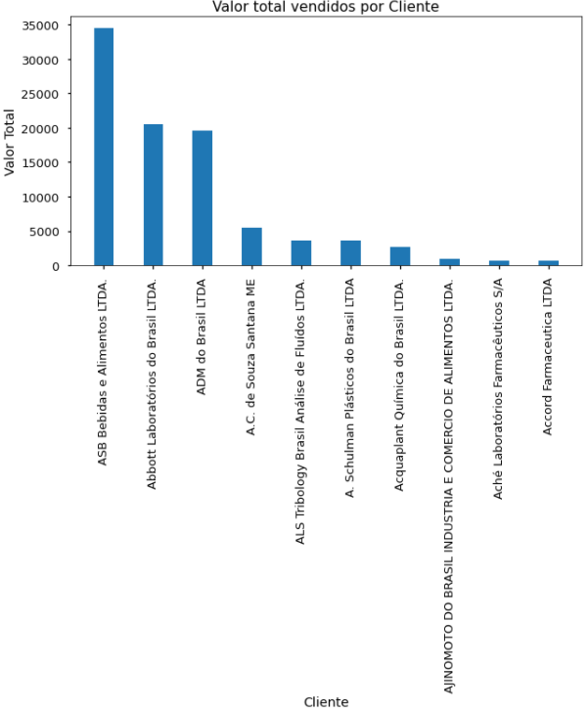
Exploratory Analysis
Number of products sold per customer

Slide 19

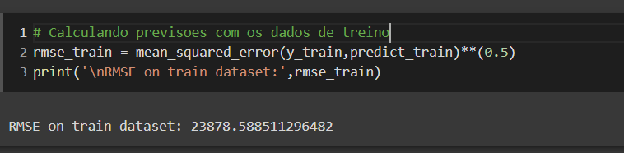
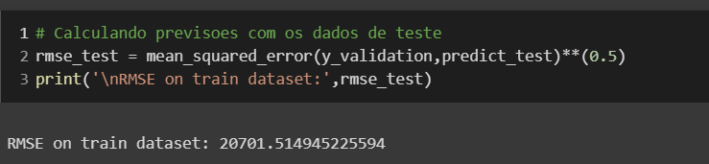
Algoritmo
The Catboost (Regression) algorithm was used to predict future slaes of each product per employee
Thus, the company will be able to otimize the stock, cost, crry out actions for the products that have most ticket to increase the billing

Slide 20

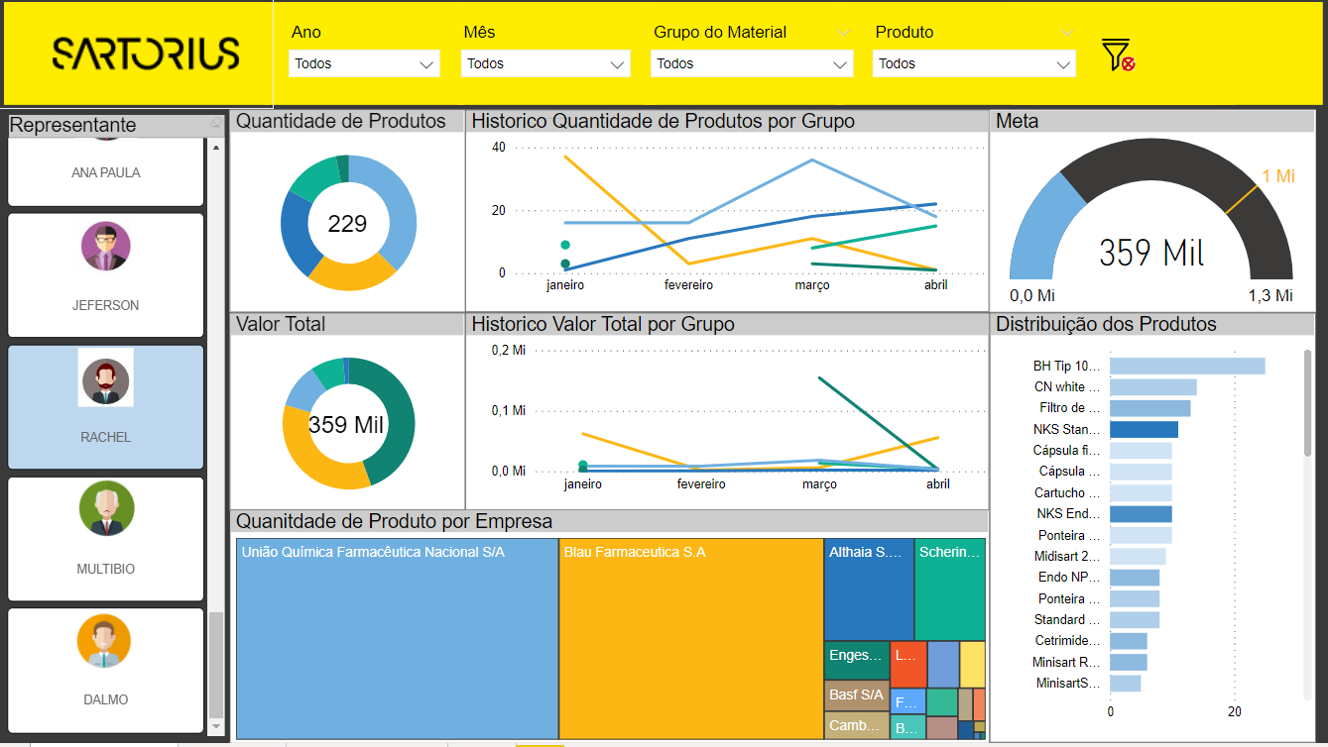
Dashboard

